Slide 1
MUNICIPAL SOLID WASTE MANAGEMENT 18CEO306T IV

Slide 2
TOPICS
Waste Processing Techniques
Purpose of Processing
Mechanical Volume and Size Reduction
Volume reduction or compaction
Size reduction or shredding
Component Separation Air separation
Magnetic separation
Screening
Other separation techniques
Composting and their factors
Benefits, Processes, types and Technologies
Biogasification – Anaerobic processing
Environmental effects
Incineration, Pyrolysis and energy recovery
Drying and Dewatering

Slide 3
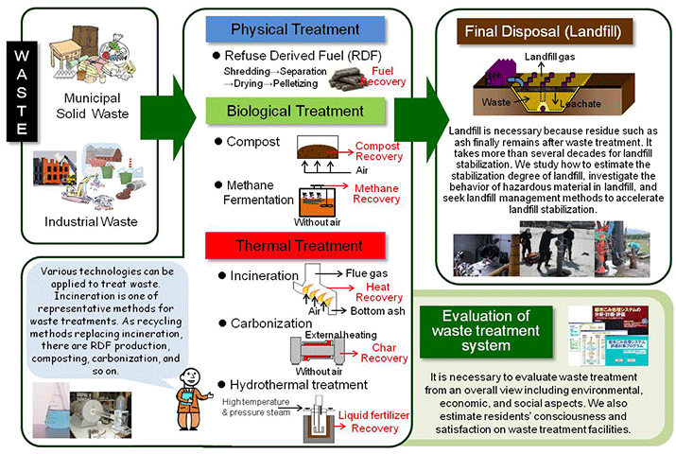
WASTE PROCESSING TECHNIQUES

Slide 4
WASTE PROCESSING TECHNIQUES
PURPOSE OF PROCESSING:
The processing of wastes helps in achieving the best possible benefit from every functional element of the solid waste management (SWM) system and, therefore, requires proper selection of techniques and equipment for every element.
Accordingly, the wastes that are considered suitable for further use need to be paid special attention in terms of processing, in order that we could derive maximum economical value from them.

Slide 5
WASTE PROCESSING TECHNIQUES
The purposes of processing, essentially, are
(i) Improving efficiency of SWM system: Various processing techniques are available to improve the efficiency of SWM system. For example, before waste papers are reused, they are usually baled to reduce transporting and storage volume requirements. In some cases, wastes are baled to reduce the haul costs at disposal site, where solid wastes are compacted to use the available land effectively. If solid wastes are to be transported hydraulically and pneumatically, some form of shredding is also required. Shredding is also used to improve the efficiency of the disposal site.

Slide 6
WASTE PROCESSING TECHNIQUES
(ii) Recovering material for reuse: Usually, materials having a market, when present in wastes in sufficient quantity to justify their separation, are most amenable to recovery and recycling. Materials that can be recovered from solid wastes include paper, cardboard, plastic, glass, ferrous metal, aluminium and other residual metals.
(iii) Recovering conversion products and energy: Combustible organic materials can be converted to intermediate products and ultimately to usable energy. This can be done either through incineration, pyrolysis, composting or bio-digestion. Initially, the combustible organic matter is separated from the other solid waste components. Once separated, further processing like shredding and drying is necessary before the waste material can be used for power generation.

Slide 7
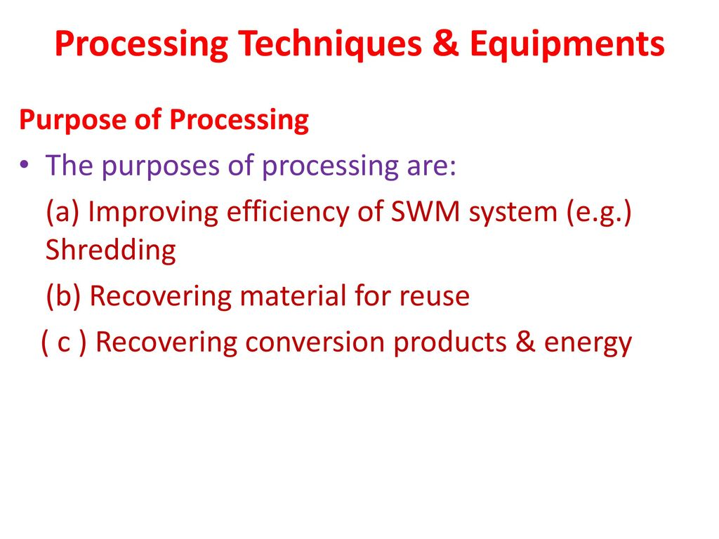
PROCESSING TECHNIQUES AND EQUIPMENT

Slide 8
MECHANICAL VOLUME AND SIZE REDUCTION
Mechanical volume and size reduction is an important factor in the development and operation of any SWM system.
The main purpose is to reduce the volume (amount) and size of waste, as compared to its original form, and produce waste of uniform size.
We will discuss the processes involved in volume and size reduction along with their selection criteria, equipment requirement, design consideration, etc.
Volume reduction or compaction
Volume reduction or compaction refers to densifying wastes in order to reduce their volume. Some of the benefits of compaction include:
reduction in the quantity of materials to be handled at the disposal site;
improved efficiency of collection and disposal of wastes;
increased life of landfills;
Economically viable waste management system.

Slide 9
EQUIPMENT USED FOR COMPACTION
STATIONARY EQUIPMENT:
This represents the equipment in which wastes are brought to, and loaded into, either manually or mechanically.
In fact, the compaction mechanism used to compress waste in a collection vehicle, is a stationary compactor.
According to their application, stationary compactors can be described as light duty (e.g., those used for residential areas), commercial or light industrial, heavy industrial and transfer station compactors.
Usually, large stationary compactors are necessary, when wastes are to be compressed into steel containers that can be subsequently moved manually or mechanically.

Slide 10
COMPACTORS
Low-pressure (less than 7kg/cm2) compaction:
This includes those used at apartments and commercial establishments, bailing equipment used for waste papers and cardboards and stationary compactors used at transfer stations.
In low-pressure compaction, wastes are compacted in large containers.
Note that portable stationary compactors are being used increasingly by a number of industries in conjunction with material recovery options, especially for waste paper and cardboard.
HIGH-PRESSURE (MORE THAN 7KG/CM2) COMPACTION:
Compact systems with a capacity up to 351.5 kg/cm2 or 5000 lb/in2 come under this category.
In such systems, specialised compaction equipment are used to compress solid wastes into blocks or bales of various sizes.
In some cases, pulverised wastes are extruded after compaction in the form of logs.
The volume reduction achieved with these high-pressure compaction systems varies with the characteristics of the waste.
Typically, the reduction ranges from about 3 to 1 through 8 to 1.

Slide 11
SIZE REDUCTION OR SHREDDING
Size reduction helps in obtaining the final product in a reasonably uniform and considerably reduced size in comparison to the original form.
This is required to convert large sized wastes (as they are collected) into smaller pieces.
https://www.youtube.com/watch?v=UM5g8rbWOlQ

Slide 12
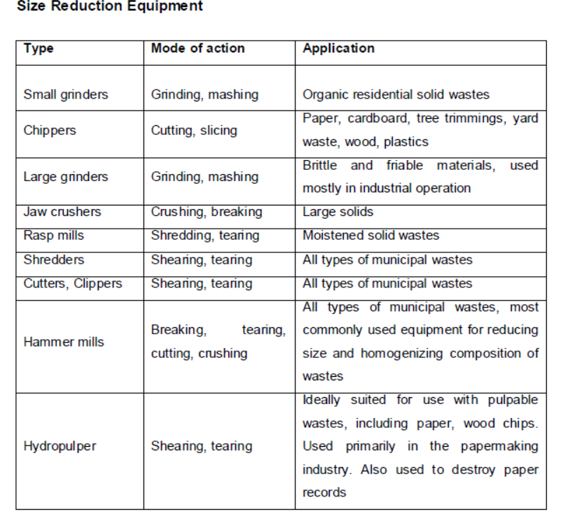
SIZE REDUCTION OR SHREDDING

Slide 13
SHREDDING EQUIPMENT
Shredding equipment - Hammer mill:
These are used most often in large commercial operations for reducing the size of wastes.
Hammer mill is an impact device consisting of a number of hammers, fastened flexibly to an inner disk, as shown in Fig, which rotates at a very high speed.
Solid wastes, as they enter the mill (see Figure), are hit by sufficient force, which crush or tear them with a velocity so that they do not adhere to the hammers.
Wastes are further reduced in size by being struck between breaker plates and/or cutting bars fixed around the periphery of the inner chamber.
This process of cutting and striking action continues, until the required size of material is achieved and after that it falls out of the bottom of the mill.
.

Slide 14
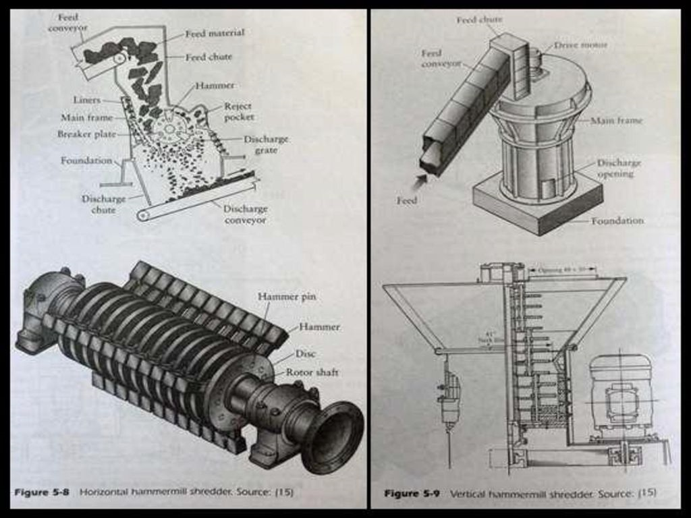

Slide 15
HYDROPULPER
Solid wastes and recycled wastes are added to the hydropulper
The high-speed cutting blades, mounted on a rotor in the bottom of the unit, convert pulpable and friable materials into slurry with a solid content varying from 2.5 to 3.5%. Metal, tins, cans and other non-pulpable or non-friable materials are rejected from the side of the hydropulper tank.
The rejected material passes down a chute that is connected to a bucket elevator, while the solid slurry passes out through the bottom of the pulper tank and is pumped to the next processing operation.

Slide 16
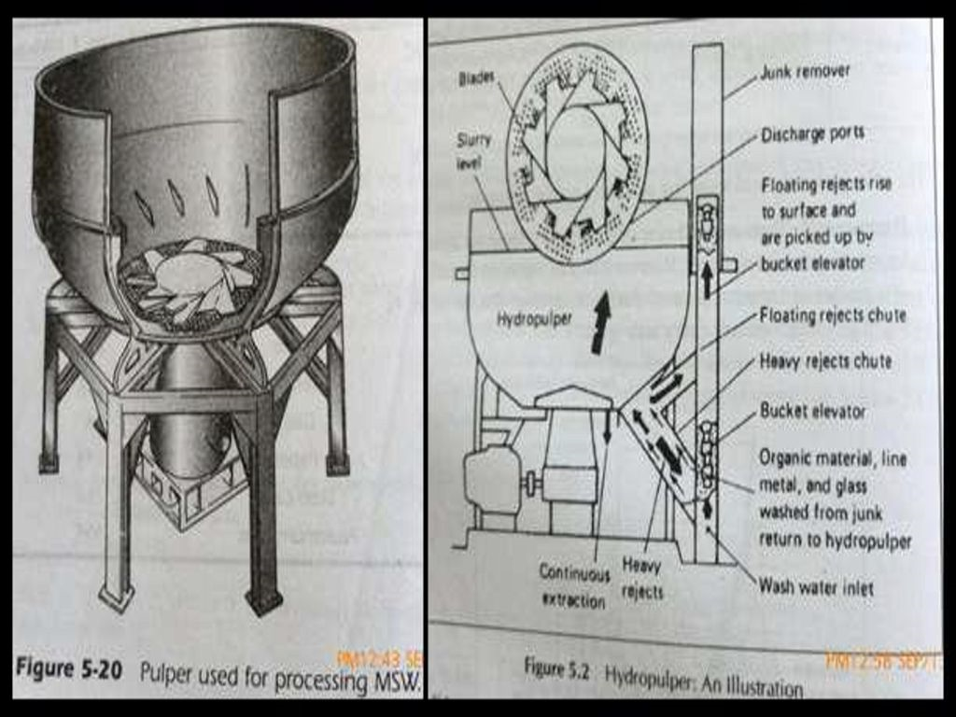
HYDROPULPER

Slide 17
COMPONENT - SEPARATION
Component separation is a necessary operation in which the waste components are identified and sorted either manually or mechanically to aid further processing.
This is required for the:
recovery of valuable materials for recycling;
preparation of solid wastes by removing certain components prior to incineration, energy recovery, composting and biogas production.

Slide 18
COMPONENT - SEPARATION
AIR SEPARATION :
This technique has been in use for a number of years in industrial operations for segregating various components from dry mixture.
Air separation is primarily used to separate lighter materials (usually organic) from heavier (usually inorganic) ones.
The lighter material may include plastics, paper and paper products and other organic materials. Generally, there is also a need to separate the light fraction of organic material from the conveying air streams, which is usually done in a cyclone separator.
In this technique, the heavy fraction is removed from the air classifier (i.e., equipment used for air separation) to the recycling stage or to land disposal, as appropriate.
The light fraction may be used, with or without further size reduction, as fuel for incinerators or as compost material.

Slide 19
CONVENTIONAL CHUTE TYPE
In this type, when the processed solid wastes are dropped into the vertical chute, the lighter material is carried by the airflow to the top while the heavier materials fall to the bottom of the chute.
The control of the percentage split between the light and heavy fraction is accomplished by varying the waste loading rate, airflow rate and the cross section of chute.
A rotary air lock feed mechanism is required to introduce the shredded wastes into the classifier.

Slide 20
ZIGZAG AIR CLASSIFIER
An experimental zigzag air classifier, shown in Figure below, consists of a continuous vertical column with internal zigzag deflectors through which air is drawn at a high rate.
Shredded wastes are introduced at the top of the column at a controlled rate, and air is introduced at the bottom of the column.
As the wastes drop into the air stream, the lighter fraction is fluidized and moves upward and out of column, while the heavy fraction falls to the bottom.
Best separation can be achieved through proper design of the separation chamber, airflow rate and influent feed rate.

Slide 21
OPEN INLET VIBRATOR TYPE
This helps to stratify the material fed to the separator into heavy and light components.
Due to this agitation, the heavier particles tend to settle at the bottom as the shredded waste is conveyed down the length of the separator.

Slide 22
MAGNETIC SEPARATION
The most common method of recovering ferrous scrap from shredded solid wastes involves the use of magnetic recovery systems.
Ferrous materials are usually recovered either after shredding or before air classification.
When wastes are mass-fired in incinerators, the magnetic separator is used to remove the ferrous material from the incinerator residue.
Magnetic recovery systems have also been used at landfill disposal sites.
The specific locations, where ferrous materials are recovered will depend on the objectives to be achieved, such as reduction of wear and tear on processing and separation equipment, degree of product purity achieved and the required recovery efficiency.

Slide 23
EQUIPMENT USED FOR MAGNETIC SEPARATION SUSPENDED MAGNET
In this type of separator, a permanent magnet is used to attract the ferrous metal from the waste stream. When the attracted metal reaches the area, where there is no magnetism, it falls away freely. This ferrous metal is then collected in a container.
This type of separation device is suitable for processing raw refuse, where separators can remove large pieces of ferrous metal easily from the waste stream.
https://www.bunting-redditch.com/magnetic-separators/

Slide 24
EQUIPMENT USED FOR MAGNETIC SEPARATION SUSPENDED MAGNET
MAGNETIC PULLEY:
This consists of a drum type device containing permanent magnets or electromagnets over which a conveyor or a similar transfer mechanism carries the waste stream.
The conveyor belt conforms to the rounded shape of the magnetic drum and the magnetic force pulls the ferrous material away from the falling stream of solid waste.

Slide 25
SCREENING
Screening is the most common form of separating solid wastes, depending on their size by the use of one or more screening surfaces.
Screening has a number of applications in solid waste resource and energy recovery systems.
Screens can be used before or after shredding and after air separation of wastes in various applications dealing with both light and heavy fraction materials.
The most commonly used screens are rotary drum screens and various forms of vibrating screens.

Slide 26
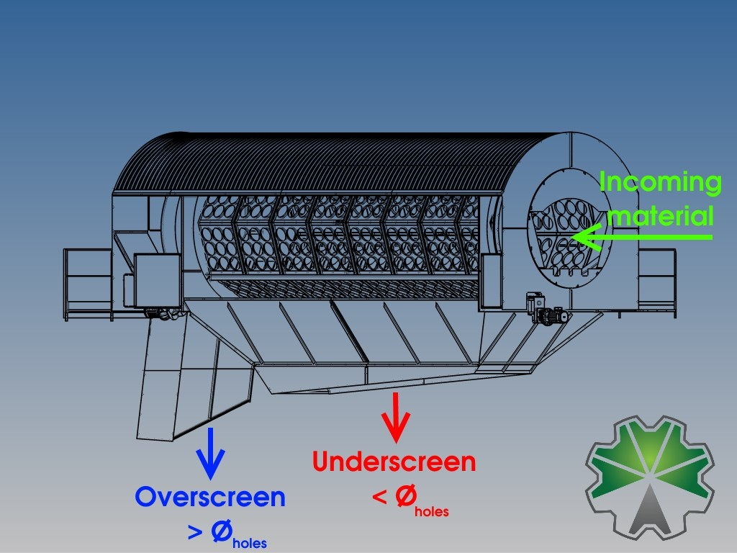
SCREENING

Slide 27
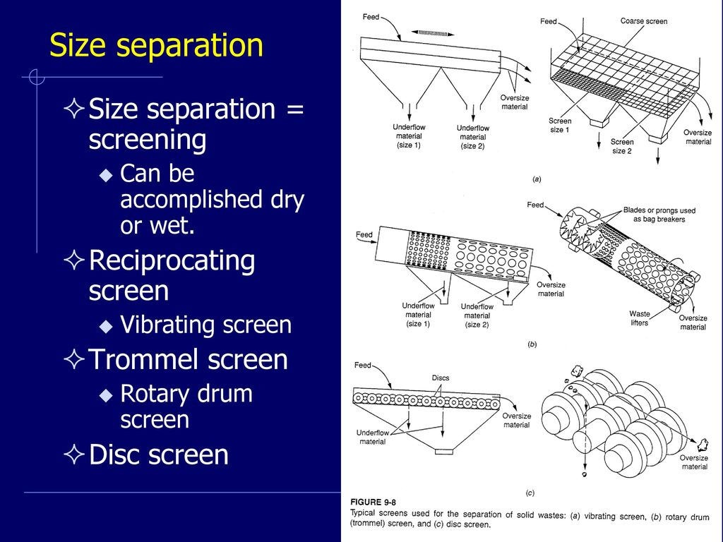
SCREENING

Slide 28
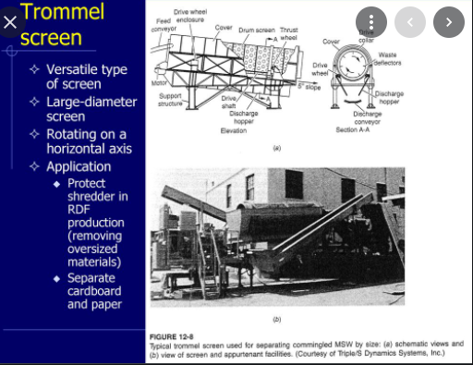
SCREENING

Slide 29
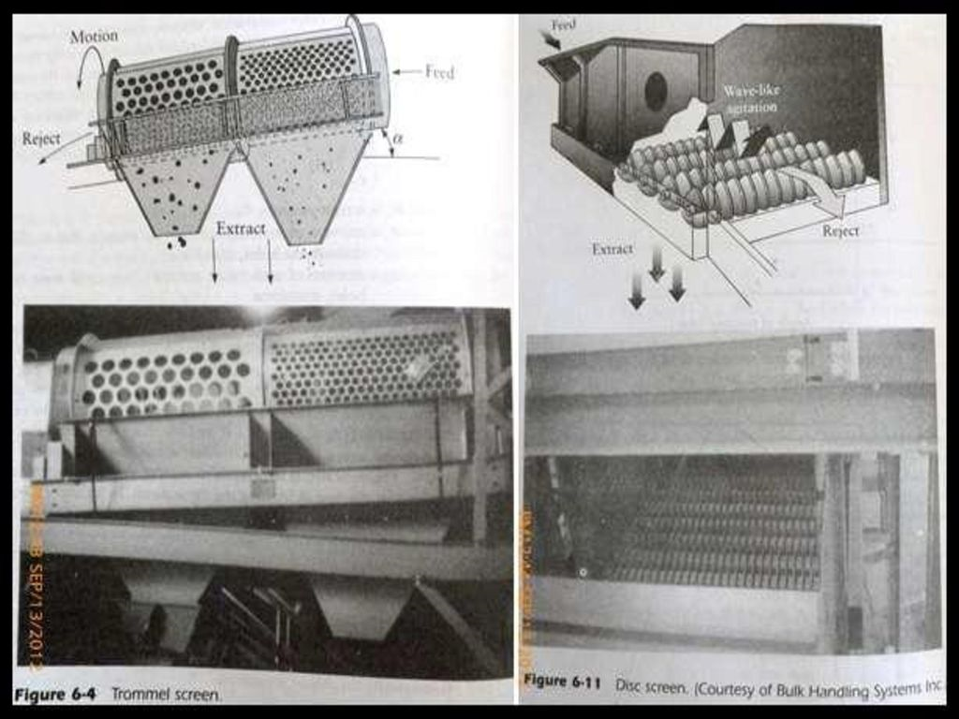
SCREENING

Slide 30
OTHER SEPARATION TECHNIQUES
HAND-SORTING OR PREVIEWING:
Previewing of the waste stream and manual removal of large sized materials is necessary, prior to most types of separation or size reduction techniques.
This is done to prevent damage or stoppage of equipment such as shredders or screens, due to items such as rugs, pillows, mattresses, large metallic or plastic objects, wood or other construction materials, paint cans, etc.
INERTIAL SEPARATION:
Inertial methods rely on ballistic or gravity separation principles to separate shredded solid wastes into light (i.e., organic) and heavy (i.e., inorganic) particles.
Mainly two different types of inertial separators based on the modes of operation
Ballistic Inertial Separator
Inclined Conveyor Separator

Slide 31
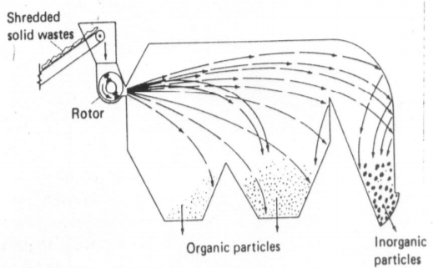
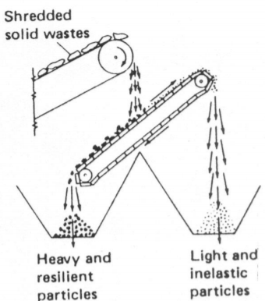
OTHER SEPARATION TECHNIQUES
BALLISTIC INERTIAL SEPARATOR
INCLINED CONVEYOR SEPARATOR

Slide 32
OTHER SEPARATION TECHNIQUES
FLOTATION:
In the flotation process, glass-rich feedstock, which is produced by screening the heavy fraction of the air-classified wastes after ferrous metal separation, is immersed in water in a soluble tank.
Glass chips, rocks, bricks, bones and dense plastic materials that sink to the bottom are removed with belt scrappers for further processing.
Light organic and other materials that float are skimmed from the surface. These materials are taken to landfill sites or to incinerators for energy recovery.
Chemical adhesives (flocculants) are also used to improve the capture of light organic and fine inorganic materials.

Slide 33
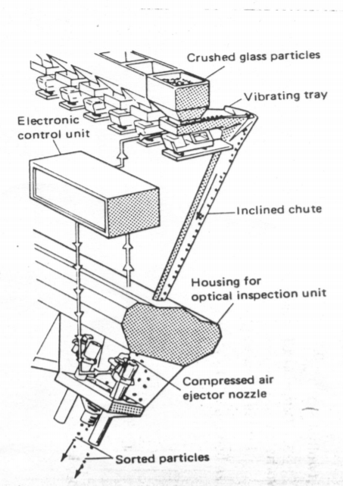
OTHER SEPARATION TECHNIQUES
OPTICAL SORTING:
Optical sorting is used mostly to separate glass from the waste stream, and this can be accomplished by identification of the transparent properties of glass to sort it from opaque materials (e.g., stones, ceramics, bottle caps, corks, etc.) in the waste stream.
Optical sorting involves a compressed air blast that removes or separates the glasses – plain or colored.
An optical sorting machinery is, however, complex and expensive.
SIMPLIFIED SCHEME OF ELECTRONIC SORTER

Slide 34
COMPOSTING AND THEIR FACTORS
Biodegradation is a natural, ongoing biological process that is a common occurrence in both human-made and natural environments.
Composting is a diverse practice that includes a variety of approaches, depending on the type of organic materials being composted and the desired properties of the final product. it is necessary to control the environmental conditions during the composting process.
The overall composting process can be explained as follows:
Organic matter + O2 + aerobic bacteria CO2 + NH3 + H2O + other end products + energy
Compost is the end product of the composting process.
The by-products of this process are carbon dioxide and water.

Slide 35
BENEFITS
Composting is one of the important components of solid waste management (SWM).
It is a form of source reduction or waste prevention, as the materials are completely diverted from the disposal facilities and require no management or transportation.
Composting owes its current popularity to several factors, including increased landfill tipping fees, shortage of landfill capacity and increasingly restrictive measures imposed by regulatory agencies.

Slide 36
BENEFITS
Composting may also offer an attractive economic advantage for communities where the costs of using other options are high.
Compost, because of its high organic matter content, makes a valuable soil amendment and is used to provide nutrients for plants.
When mixed with soil, compost promotes a proper balance between air and water in the resulting mixture, helps reduce soil erosion and serves as a slow-release fertilizer.

Slide 37
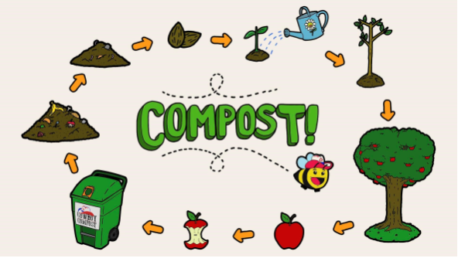
COMPOSTING
Composting is the biological decomposition of organic waste under controlled aerobic condition.
Industries as paper, agricultural and food processing give out wastes which are almost 100% organic. This organic matter can be composted to yield good manure.
Compost is the end product obtained after subjecting the organic fraction of solid waste to aerobic or anaerobic decomposition to yield humus like solid, carbon dioxide, water vapour and energy.
COMPOSTING PROCESS

Slide 38
MECHANISM OF COMPOSTING:
Composting is a very complex process involving the participation of several microorganisms like bacteria, actinomycetes and fungi.
The bacteria bring out the decomposition of macromolecule namely proteins and lipids. Besides generating energy (heat) Fungi and actinomycetes degrade cellulose and other complex organic compounds.
Composting may be divided into three stages with reference to changes in temperature:
Mesophilic stage
Thermophilic stage
Cooling stage

Slide 39
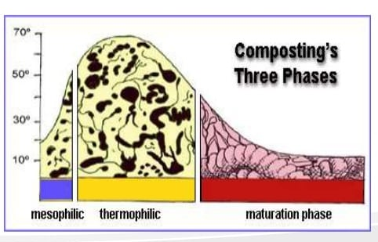
PHASE OF COMPOSTING:

Slide 40
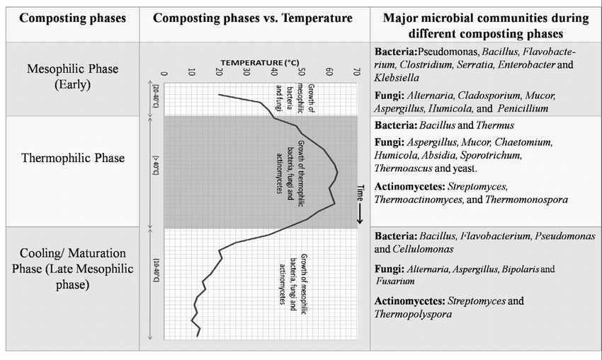
PHASE OF COMPOSTING:

Slide 41
VERMICOMPOSTING
Vermicomposting is a simple biotechnological process of composting, in which certain species of earthworms are used to enhance the process of waste conversion and produce a better end product.
Vermicomposting differs from composting in several ways.
Utilizing microorganism’s (earthworms that are active at 10– 32°C).
The process is faster than composting (Because the material passes through the earthworm gut, a significant but not yet fully understood transformation takes place, whereby the resulting earthworm castings (worm manure) are rich in microbial activity and plant growth regulators).

Slide 42
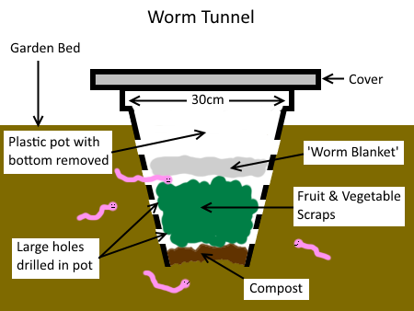

Slide 43
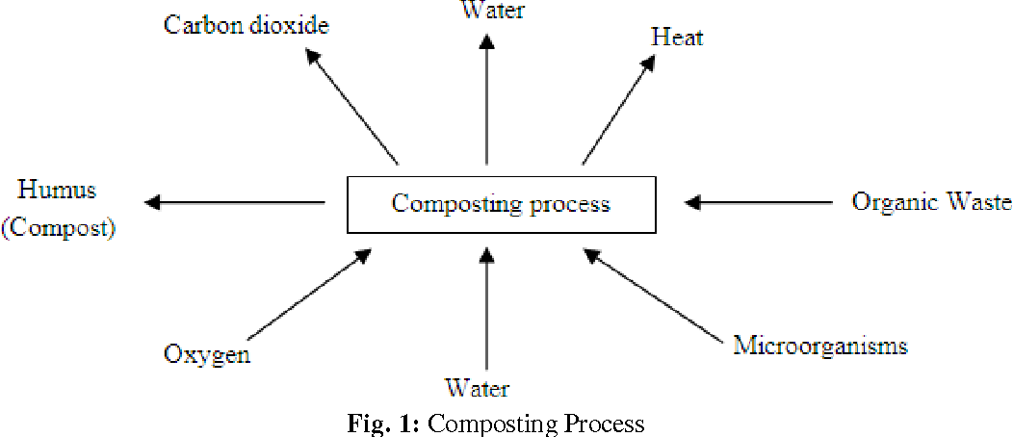
COMPOSTING

Slide 44
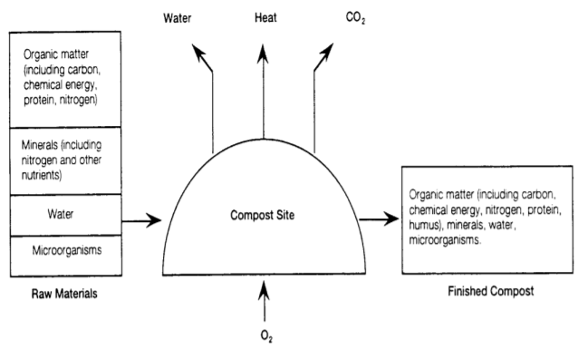
COMPOSTING PROCESS
Several factors contribute to the success of composting including physical, chemical, and biological processes.
Composting Process

Slide 45
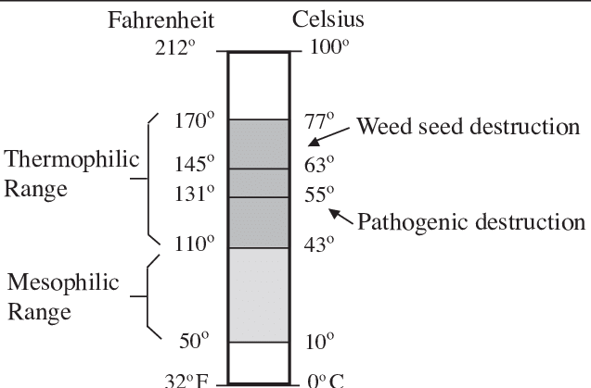
PROCESSES AND TYPES
Biological processes:
Microorganisms such as bacteria, fungi and actinomycetes as well as larger organisms such as insects and earthworms play an active role in decomposing the organic materials.
As microorganisms begin to decompose the organic material, they break down organic matter and produce carbon dioxide, water, heat and humus (the relatively stable organic end product). This humus end product is compost.
Under optimal conditions, composting proceeds through the following four phases
(i) Mesophilic, or moderate-temperature phase
(ii) Thermophilic, or high-temperature phase
(iii) Cooling phase
(iv) Maturation or curing phase

Slide 46
PROCESSES AND TYPES
MESOPHILIC, OR MODERATE-TEMPERATURE PHASE:
Compost bacteria combine carbon with oxygen to produce carbon dioxide and energy.
The microorganisms for reproduction and growth use some of the energy and the rest is generated as heat.
When a pile of organic refuse begins to undergo the composting process, mesophilic bacteria proliferate, raising the temperature of the composting mass up to 44°C. This is the first stage of the composting process.
These mesophilic bacteria can include E. coli and other bacteria from the human intestinal tract, but these soon become increasingly inhibited by the temperature, as the thermophilic bacteria take over in the transition range of 44°C – 52°C.

Slide 47
PROCESSES AND TYPES
THERMOPHILIC, OR HIGH-TEMPERATURE PHASE:
In the second stage of the process, the thermophilic microorganisms are very active and produce heat.
This stage can continue up to about 70°C, although such high temperatures are neither common nor desirable in compost.
This heating stage takes place rather quickly and may last only a few days, weeks, or months. It tends to remain localised in the upper portion of a compost pile where the fresh material is being added, whereas in batch compost, the entire composting mass may be thermophilic all at once.
After the thermophilic heating period, the manure will appear to have been digested, but the coarser organic material will not be digested.
This is when the third stage of composting, i.e., the cooling phase, takes place.

Slide 48
PROCESSES AND TYPES
COOLING PHASE:
During this phase, the microorganisms that were replaced by the thermophiles migrate back into the compost and digest the more resistant organic materials.
Fungi and microorganisms such as earthworms and sow bugs that break the coarser elements down into humus also move back in.
MATURATION OR CURING PHASE:
The final stage of the composting process is called curing, ageing, or maturing stage, and is a long and important one
A long curing period (e.g., a year after the thermophilic stage) adds a safety net for pathogen destruction.
Many pathogens have a limited period of viability in the soil, and the longer they are subjected to the microbiological competition of the compost pile the more likely they will die a swift death.

Slide 49
PROCESSES AND TYPES
CHEMICAL PROCESSES:
Several factors determine the chemical environment for composting includes
PRESENCE OF AN ADEQUATE CARBON FOOD/ENERGY SOURCE
For their carbon/energy source, microorganisms in the composting process rely on carbon in the organic material, unlike higher plants that rely on carbon dioxide and sunlight.
The carbon contained in natural or human-based organic materials may or may not be biodegradable.

Slide 50
PROCESSES AND TYPES
BALANCED AMOUNT OF NUTRIENTS
To aid the decomposition process, the bulk of the organic matter should be carbon with just enough nitrogen.
In general, an initial ratio of 30:1 (C: N or Carbon: Nitrogen) is considered ideal. Higher ratios tend to retard the process of decomposition, while ratios below 25:1 may result in odour problems.
As the composting process proceeds and carbon is lost to the atmosphere, this ratio decreases. Finished compost should have ratios of 15 to 20:1.
Adding 3 – 4 kg of nitrogen material for every 100 kg of carbon should be satisfactory for efficient and rapid composting.

Slide 51
PROCESSES AND TYPES
MOISTURE CONTENT
Water is an essential part of all forms of life, and the microorganisms living in a compost pile are no exception.
Since most compostable materials have lower than ideal water content, i.e., 50 to 60% of total weight, the composting process may be slower than desired, if water is not added.
Adding moisture may be necessary to keep the composting process performing at its peak.

Slide 52
PROCESSES AND TYPES
ADEQUATE OXYGEN:
Composting is considered an aerobic process. Decomposition can occur under both aerobic (requiring oxygen) and anaerobic (lacking oxygen) conditions.
A 10 to 15% oxygen concentration is considered adequate, although a concentration as low as 5% may be sufficient for leaves.

Slide 53
PROCESSES AND TYPES
APPROPRIATE pH:
The pH factor affects the amount of nutrients available for the microorganisms, the solubility of heavy metals and the overall metabolic activity of the microorganisms.
A pH between 6 and 8 is considered optimum, and it can be adjusted upward by the addition of lime, or downward with sulphur, although such additions are normally not necessary.

Slide 54
PROCESSES AND TYPES
PHYSICAL PROCESSES
The physical environment in the compost process includes factors such as
Particle size
Temperature
Mixing and pile size
PARTICLE SIZE:
As composting progresses, there is a natural process of size reduction and the particle size of the material being composted is critical.
Because smaller particles usually have more surface area per unit weight, they facilitate more microbial activity on their surfaces, which leads to rapid decomposition.

Slide 55
PROCESSES AND TYPES
TEMPERATURE:
Composting can occur at a range of temperatures, and the optimum temperature range is between 32° and 60° C.
Temperatures above 65° C are not ideal for composting as thermal destruction of cell proteins kill the organisms.
Similarly, temperatures below the minimum required for a group of organisms affect the metabolic activity (i.e., regulatory machinery) of the cells.
MIXING:
Mixing of feedstock, water and inoculants is important and is done by turning or mixing the piles after composting has begun.
Mixing and agitation distribute moisture and air evenly, and promote the breakdown of compost clumps.

Slide 56
TECHNOLOGIES
Composting technologies are as follows
Windrow composting
Aerated static pile composting
In-vessel composting system
Anaerobic composting

Slide 57
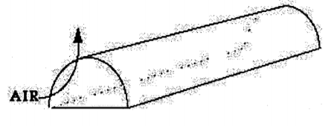
TECHNOLOGIES
WINDROW COMPOSTING:
Windrows composed of MSW are usually required to be located on an impermeable surface, which greatly improves equipment handling under inclement weather conditions.
Process control is normally through pile management, although forced aeration can also be used.
Turning the pile re-introduces air into the pile and increases porosity so that efficient passive aeration from atmospheric air continues at all times.
The windrow dimensions should allow conservation of the heat generated during the composting process and also allow air to diffuse to the deeper portions of the pile.

Slide 58
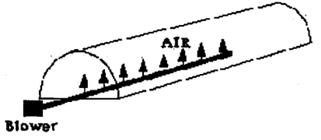
TECHNOLOGIES
AERATED STATIC PILE COMPOSTING:
Aerated static pile composting is a non-proprietary technology that requires the composting mixture (i.e., a mixture of pre-processed materials and liquids) to be placed in piles that are mechanically aerated.
The piles are placed over a network of pipes connected to a blower, which supplies the air for composting.

Slide 59
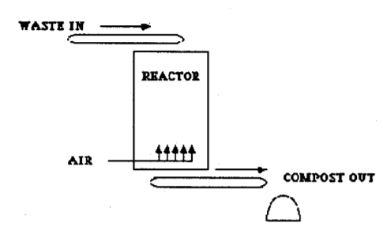
TECHNOLOGIES
IN-VESSEL COMPOSTING SYSTEM:
In-vessel composting systems enclose the feedstock in a chamber or vessel that provides adequate mixing, aeration and moisture. Drums, digester bins and tunnels are some of the common in-vessel type systems.
A major advantage of in-vessel systems is that all environmental conditions can be carefully controlled to allow rapid composting.
VERTICAL COMPOSTING REACTOR:
It is generally over 4 meters high as and can be housed in silos or other large structures

Slide 60
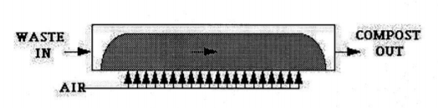
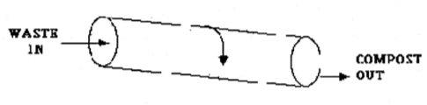
TECHNOLOGIES
2. HORIZONTAL COMPOSTING REACTORS:
These avoid high temperature, oxygen and moisture gradients of vertical reactors by maintaining a short airflow pathway. They come in a wide range of configurations, including static and agitated, pressure and/or vacuum-induced aeration.
3. ROTATING DRUM:
Rotating drum reactors take the trade-off between reactor cost and compost residence time to an even further extreme.
These reactors, also known as digesters, retain the material for only a few hours or days

Slide 61
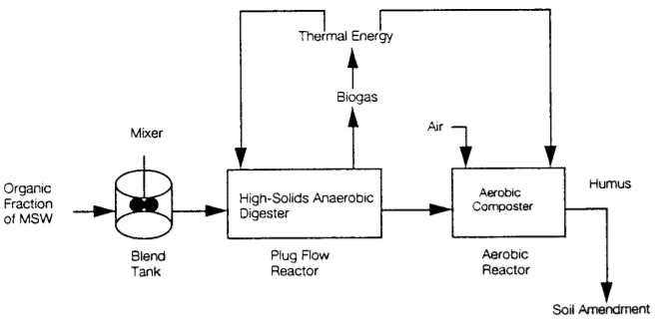
TECHNOLOGIES
ANAEROBIC COMPOSTING:
In anaerobic processes, facultative bacteria break down the organic materials in the absence of oxygen and produce methane and carbon dioxide.
Anaerobic systems, if configured efficiently, will generate sufficient energy in the form of methane to operate the process and have enough surpluses to either market as gas or convert to electricity.

Slide 62
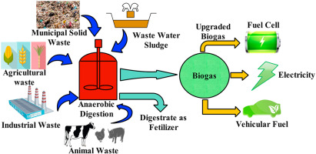
BIOGASIFICATION-ANAEROBIC PROCESSING

Slide 63
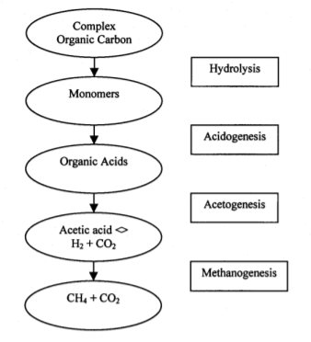
BIOGASIFICATION-ANAEROBIC PROCESSING
Biogas is a mixture of gases composed of methane (CH4) 40 – 70 vol.%, carbon dioxide (CO2) 30 – 60 vol.%, other gases 1 – 5 vol.% including, hydrogen (H2) 0 – 1 vol.% and hydrogen sulphide (H2S) 0 – 3 vol.%. It originates from bacteria in the process of bio-degradation of organic material under anaerobic (without air) conditions.
Anaerobic processing of organic material is a two-stage process, where large organic polymers are fermented into short-chain volatile fatty acids. These acids are then converted into methane and carbon dioxide.

Slide 64
BIOGASIFICATION-ANAEROBIC PROCESSING
According to the solid content of the material digested and the temperature at which the process operates, the various Biogasification processes can be classified as under:
DRY ANAEROBIC DIGESTION: In dry anaerobic digestion, semi-solid wastes are digested to produce biogas in a single stage, either as a batch process or a continuous process.
WET ANAEROBIC DIGESTION: In its simplest form, this process consists of a single stage in a completely mixed mesophilic digester, operating at a total solid content of around 3 – 8%. To produce this level of dilution, a considerable amount of water has to be added and heated, and then removed after the digestion process.

Slide 65
COMPOSTING AND BIOGASIFICATION: ENVIRONMENTAL EFFECTS
Composting facilities of solid waste with manure, sewage sludge and residue from processing create some significant environmental considerations including the following:
Water impacts:
Water runoff from garden waste composting facilities could contain large concentration of nutrients (i.e., nitrates and phosphorous), volatile organics and metals that cause algal blooms in the nearby surface water.
Municipal waste composting, sludge composting involve a large amount of potential contaminants, and water impact could be greater at these facilities.
Leachate from MSW compost facilities can contain high concentration of nutrients (e.g., nitrate and phosphorous), volatile organics and metals. Leachate could affect both surface and ground water.

Slide 66
COMPOSTING AND BIOGASIFICATION: ENVIRONMENTAL EFFECTS
Land impacts:
At garden waste composting facilities, soil may become more acidic, due to the presence of certain leaves and pine needles in the compost pile.
Nitrogen depletion may also occur, which can be limited by proper burning.
MSW and co-composting facilities carry the potentially harmful impacts of acids, and organic and metal contamination.

Slide 67
COMPOSTING AND BIOGASIFICATION: ENVIRONMENTAL EFFECTS
ODOUR POLLUTION:
Odour is one of the most frequent problems at composting facilities. Frequent burning of compost piles has proven to be effective in limiting odour problems.
When in-vessel systems are used, odour control devices (e.g., air scrubber, etc.) can minimise the problem.
HEALTH IMPACT:
The primary public health concerns associated with composting operation result from: drinking contaminated water; toxins in the finished product (applied on land); pathogens.

Slide 68
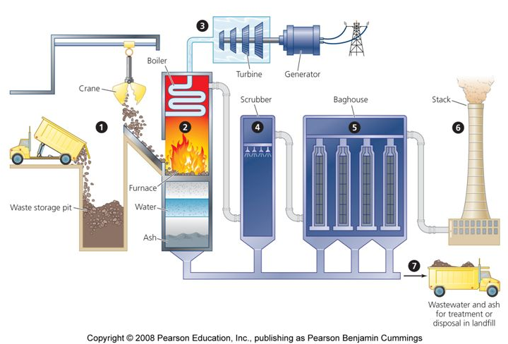
INCINERATION

Slide 69
INCINERATION
This refers to the controlled burning of wastes, at a high temperature (roughly 1200 – 1500C), which sterilises and stabilises the waste in addition to reducing its volume.
Incineration is a chemical reaction in which carbon, hydrogen and other elements in the waste mix with oxygen in the combustion zone and generates heat.
In the process, most of the combustible materials (i.e., self-sustaining combustible matter, which saves the energy needed to maintain the combustion) such as paper or plastics get converted into carbon dioxide and ash.
Incineration may be used as a disposal option, when land filling is not possible and the waste composition is highly combustible.
An appropriate technology, infrastructure and skilled workforce are required to operate and maintain the plant.

Slide 70
INCINERATION
INCINERATION OBJECTIVES
VOLUME REDUCTION:
Depending on its composition, incineration reduces the volume of solid wastes to be disposed of by an average of 90%. The weight of the solid wastes to be dealt with is reduced by 70 – 75%.
STABILISATION OF WASTE:
Incinerator output (i.e., ash) is considerably more inert than incinerator input (i.e., solid wastes), mainly due to the oxidation of the organic components of the waste stream.
This leads to a reduction of landfill management problems and the organic compounds present in landfill leachate.

Slide 71
INCINERATION
RECOVERY OF ENERGY FROM WASTE (EFW):
This represents a valorisation method, rather than just a pre-treatment of waste prior to disposal.
Energy recovered from burning the wastes is used to generate steam for use in onsite electricity generation or export to local factories or district heating schemes.
Combined heat and power plants increase the efficiency of energy recovery by producing electricity as well as utilising the residual heat.
Solid waste incineration can replace the use of fossil fuels for energy generation.
STERILISATION OF WASTE:
This is of primary importance in the incineration of clinical or biomedical waste.
Incineration of solid wastes will also ensure destruction of pathogens prior to final disposal in a landfill.

Slide 72
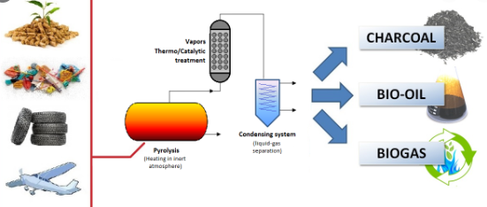
PYROLYSIS
This is the thermal degradation of carbonaceous material to gaseous, liquid and solid fraction in the absence of oxygen.
This occurs at a temperature between 200 and 900C. The product of pyrolysis is a gas of relatively high calorific value of 20,000 joules per gram with oils, tars and solid burned residue.

Slide 73
ENERGY RECOVERY
Most of the MSW incineration currently practice energy recovery in the form of steam, which is used either to drive a turbine to generate electricity or directly for heating or cooling. The three basic types of waste-to-energy incineration are:
Generation of electricity
Steam generation
Co-generation

Slide 74
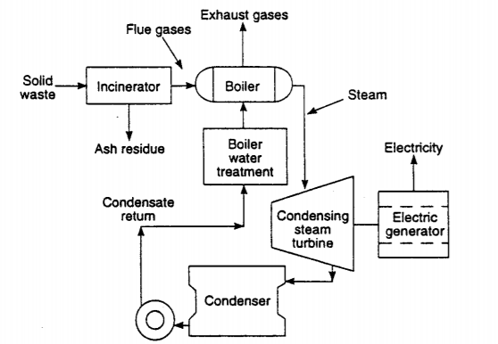
ENERGY RECOVERY
Generation of electricity
Electricity is the most common form of energy produced and sold from waste to energy (WTE).
By directing the steam produced from a WTE system through a turbine generator, electricity can be produced and sold.

Slide 75
ENERGY RECOVERY
STEAM GENERATION:
Steam is used widely in a variety of industrial applications. Steam generated in incineration facilities can also be used directly by a customer for manufacturing operations.
Steam generated in an incinerator is supplied to a customer through a steam line, and a separate line sometimes returns the condensed steam.
It can be used to drive machinery such as compressors, for space heating and generating electricity.
Industrial plants, dairies, cheese plants, public utilities, paper mills, tanneries, breweries, public buildings and many other businesses use steam for heating and air conditioning

Slide 76
ENERGY RECOVERY
CO-GENERATION:
Co-generation refers to combined production of steam and electricity and can occur in two ways.
If the energy customer requires steam conditions (pressure and temperature) that are less than the incineration plant’s design specifications, a turbine-generator is used to produce electricity and thus reduce steam conditions to appropriate levels for the customer.
If the steam purchaser cannot accept all the steam produced by the facility, the excess can be converted to electricity.
In cogeneration, high-pressure steam is used first to generate electricity; the steam leaving the turbine is then used to serve the steam users.

Slide 77
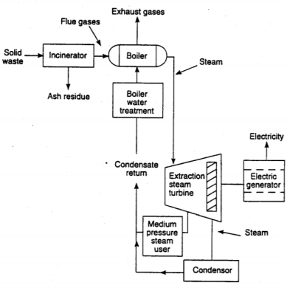
ENERGY RECOVERY
COGENERATION: provides greater overall energy efficiency, even though the output of the major energy product – whether electricity or steam – may be less than that generated by producing one type of energy alone.

Slide 78
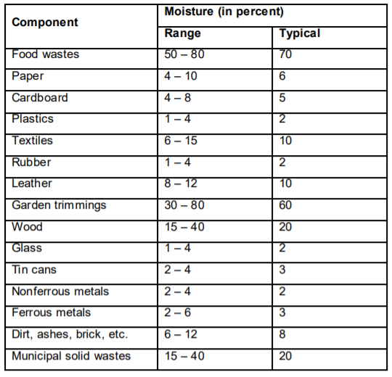
DRYING AND DEWATERING
Drying and dewatering operations are used primarily for incineration systems, with or without energy recovery systems.
These are also used for drying of sludges in wastewater treatment plants, prior to their incineration or transport to land disposal.
The purpose of drying and dewatering operation is to remove moisture from wastes and thereby make it a better fuel.
Moisture Content of Municipal Solid Waste Components

Slide 79
DRYING
(i) CONVECTION DRYING:
In this method, hot air is in direct contact with the wet solid waste stream.
(ii) CONDUCTION DRYING:
In this method, the wet solid waste stream is in contact with a heated surface.
(III) RADIATION DRYING:
In this method, heat is transmitted directly to the wet solid waste stream by radiation from the heated body.
Of these three methods, convection drying is used most commonly.

Slide 80
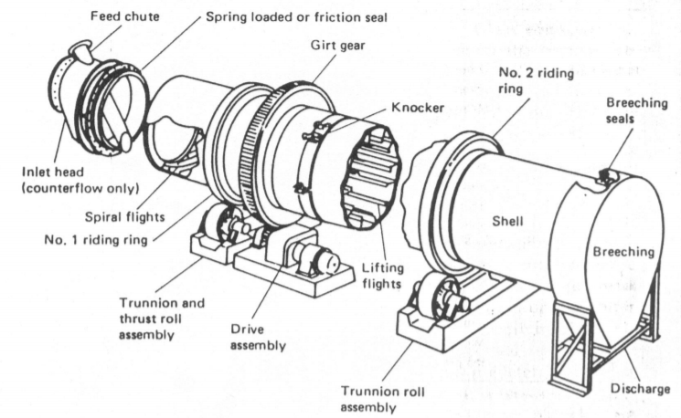
DRYING
A rotary drum dryer is composed of a rotating cylinder, slightly inclined from the horizontal through which the material to be dried and the drying gas are passed simultaneously.
COUNTERCURRENT DIRECT-HEAT ROTARY DRUM DRYER

Slide 81
DRYING
The drying of material in a direct rotary dryer occurs in the following stages:
Heating the wet material and its moisture content to the constant-rate drying temperature. Drying the material substantially at this temperature.
Heating of material to its discharge temperature and evaporation of moisture remaining at the end of the stage. The retention time in the rotary drum is about 30 – 45 minutes.
The required energy input will depend on the moisture content, and the required energy input can be estimated by using a value of about 715 KJ/kg (or 1850 Btu/1b) of water evaporated.

Slide 82
DRYING
Some of the factors, considered in the selection of a drying equipment includes the following:
Properties of material to be dried.
Drying characteristics of the materials, including moisture content, maximum material temperature and anticipated drying time.
Specification of final product, including moisture content.
Nature of operation, whether continuous or intermittent. Operational characteristics, including energy requirements, maintenance requirements, simplicity of operation, reliability, noise output and air and water pollution control requirements.
Site considerations such as space and height access, noise and environmental limitations

Slide 83
DEWATERING
Dewatering is more applicable to the problem of sludge disposal from wastewater treatment of plants, but may also be applicable in some cases to municipal/industrial waste problems.
When drying beds, lagoons or spreading on land are not feasible, other mechanical means of dewatering are used.
The emphasis in the dewatering operation is often on reducing the liquid volume.
Once dewatered, the sludge can be mixed with other solid waste, and the resulting mixture can be: incinerated to reduce volume; used for the production of recoverable by-products; used for production of compost; buried in a landfill.
Centrifugation and filtration are the two common methods for the dewatering of sludge.
Sludges with solid content of a few percent can be thickened to about 10 – 15% in centrifugation and about 20 – 30% in pressure filtration or vacuum filtration.

Slide 84
ANAEROBIC DIGESTION
Anaerobic digestion is a regulated version of the natural events of landfill, in that it results in the controlled release of methane-rich biogas, which offers the potential for a very real form of energy from waste.
It is carried out in large fermented tanks.
In these tanks, solid waste is taken in the absence of oxygen and the anaerobic bacteria convert the large organic molecules mainly into methane CH4 and carbon dioxide CO2.
Unlike composting, Anaerobic Digestion occurs at one of three distinct temperature ranges, namely:
Cryophilic (<20 ◦C)
Mesophilic (20–45 ◦C)
Thermophilic (>45 ◦C)

Slide 85
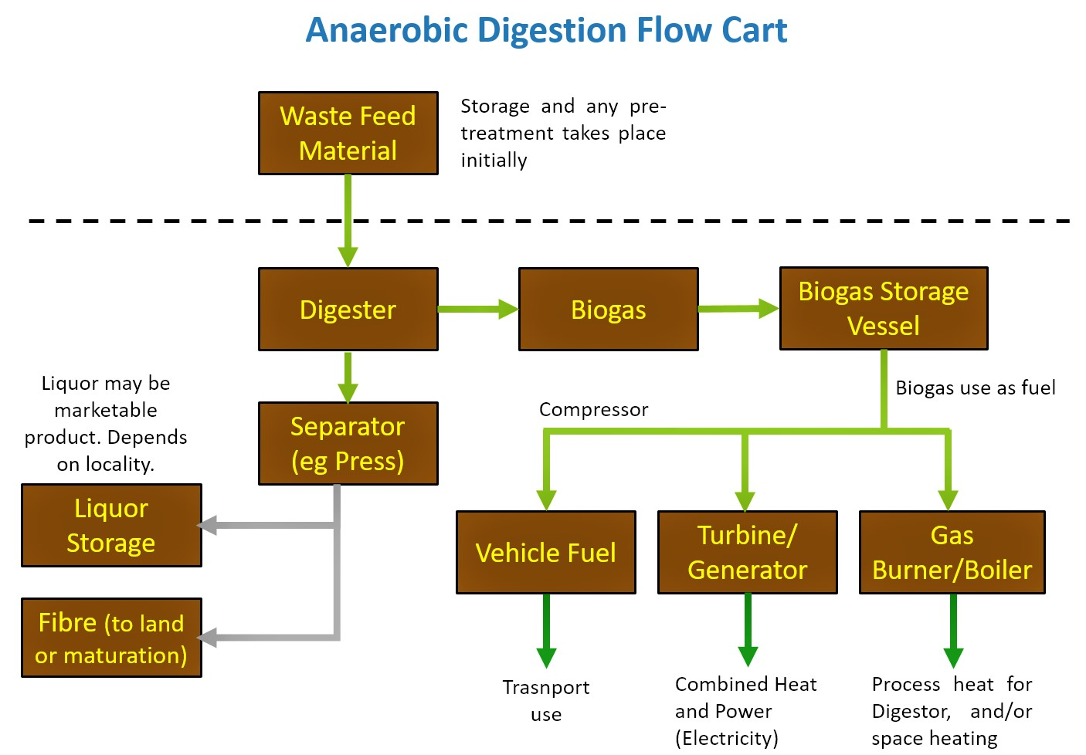
ANAEROBIC DIGESTION

Slide 86
MICRO-ORGANISMS INVOLVED IN ANAEROBIC DIGESTION
There are four main groups of bacteria involved in Anaerobic digestion, as shown below, with some typical examples of each:
Hydrolytic fermentative bacteria – Clostridium and Peptococcus.
Acetogenic bacteria – Syntrophobacter and Syntrophomonas.
Acidogenic bacteria – Methanosarcina and Methanothrix.
Methanogenic bacteria – Methanobacterium and Methanobrevibacterium.

Slide 87
Disposal by hog feeding
Disposal by hog feeding is not general procedure in India. Garbage disposal into sewers including BOD and TSS increases by 20-30%. Refuse is ground well in grinders and then fed into sewers.
Disposal by ploughing into the fields are not commonly used. These disposals are not environment friendly in general.

Slide 88
Fermentation/biological digestion
Biodegradable wastes are converted to compost and recycling can be done whenever possible. Hazardous wastes can be disposed using suitable methods.
Typical biomass biological conversion processes are fermentation and anaerobic digestion. ... For instance, starch and molasses are usually used as feedstocks to produce ethanol via fermentation, during which the simple sugars (e.g., glucose, maltose, and sucrose) are fermented into bioethanol or biobutanol.

